Slide 1
WSMTC Transition Data & Trends
Mark Sullivan
Planning & Strategy Advisor
WA ST Military transition Council
MarkS@dva.wa.gov

Slide 2
Data Sharing
WSMTC has access to data for all separating service members who plan to reside in Washington:
DD-214 data is provided electronically to WDVA by DOD’s Defense Manpower Data Center (DMDC).
DMDC recently started providing some Navy DD-214 data electronically (other data provided in hardcopy).
WDVA is currently working on a new agreement with DMDC to obtain additional demographic data (race, education, and marital status).
Through a data sharing agreement between WDVA and ESD, we can match wage and hour data.

Slide 3
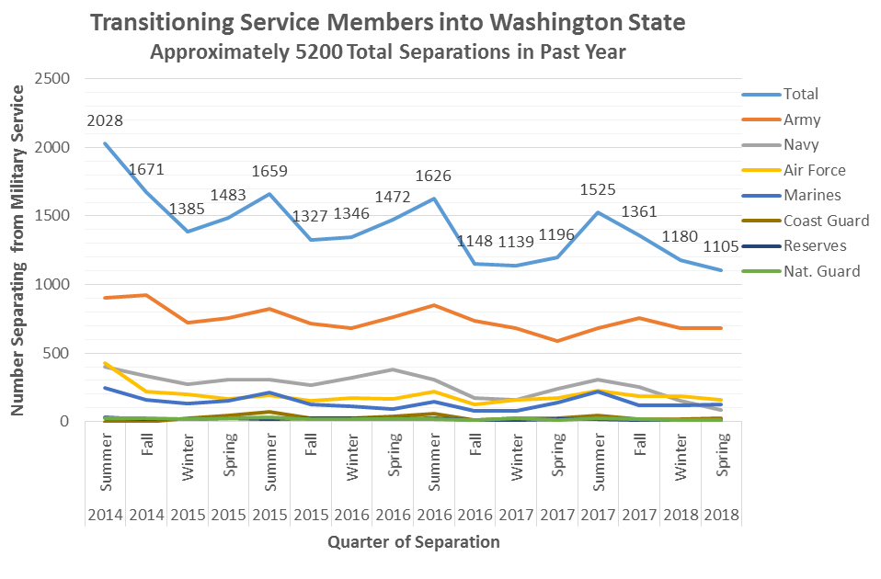
Separations from Service
~ 5200

Slide 4
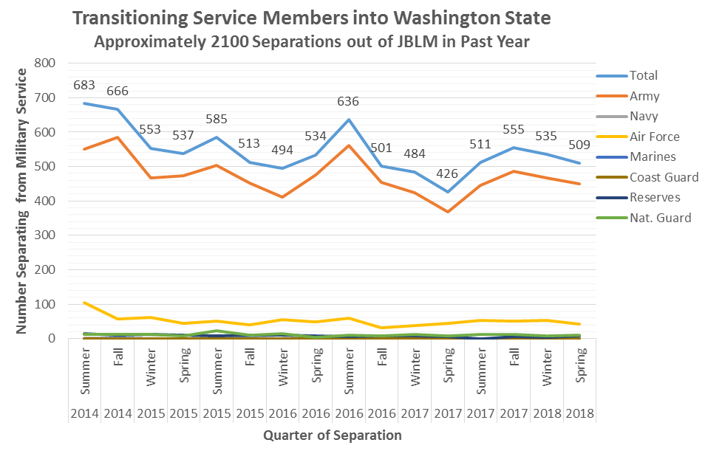
Separations from Service
~ 2100

Slide 5
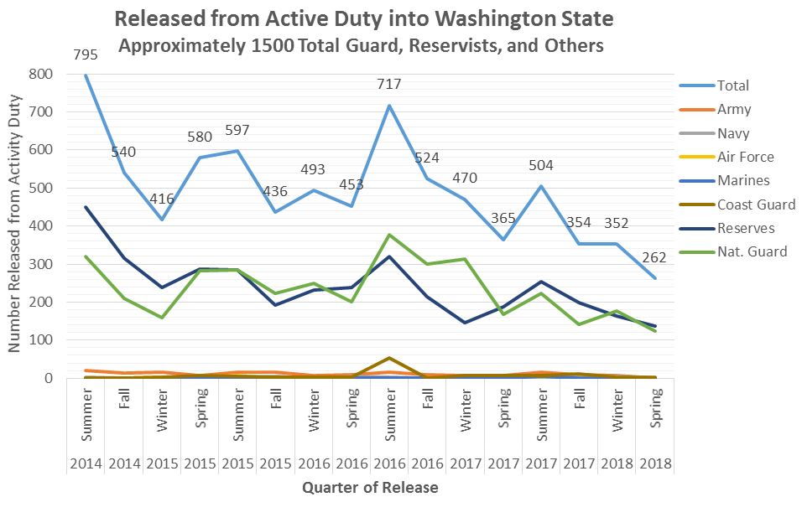
Releases from Active Duty
~ 1500

Slide 6
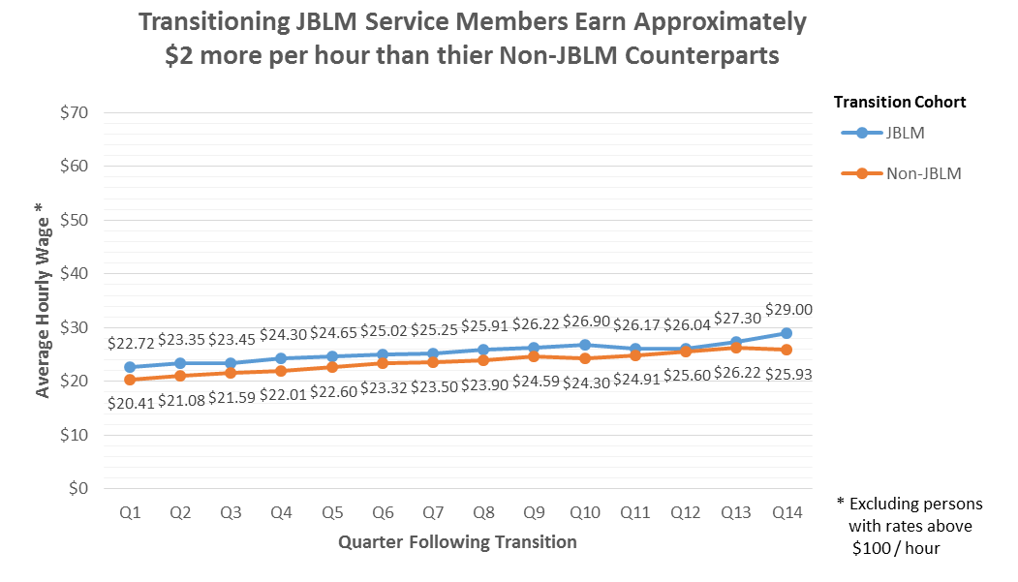
Average Wage

Slide 7
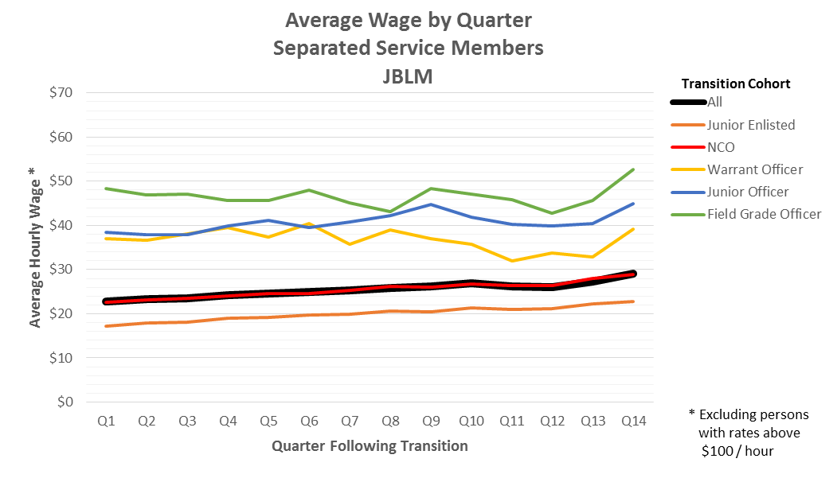
Average Wage

